Slide 1
Tank War
FINAL REPORT
Artificial Intelligence 2023-2024

Slide 2
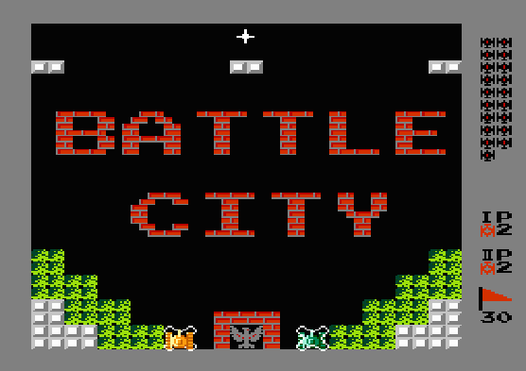
Background
Tank war : 2-D board multi-directional shooter
A Popular Instance: Battle City released in 1985 on FC/NES
Maps (boards) are made of grids on a panel
Arbitrary numbers of players and enemies (cannot overlay)
(We will only involve single player in our project)
What's more...
Player and enemies shoot shells
One side wins if and only if all opponents are dead (or their headquater is destroyed)
A grid can be empty, breakable/unbreakable wall, water (block tanks but not shells), ......
https://www.retrogames.cz/play_014-NES.php
Notes:
坦克大战：红白机的经典游戏
地图也是平面网格，玩家和敌人数量任意（我们会专注于单个玩家）

Slide 3
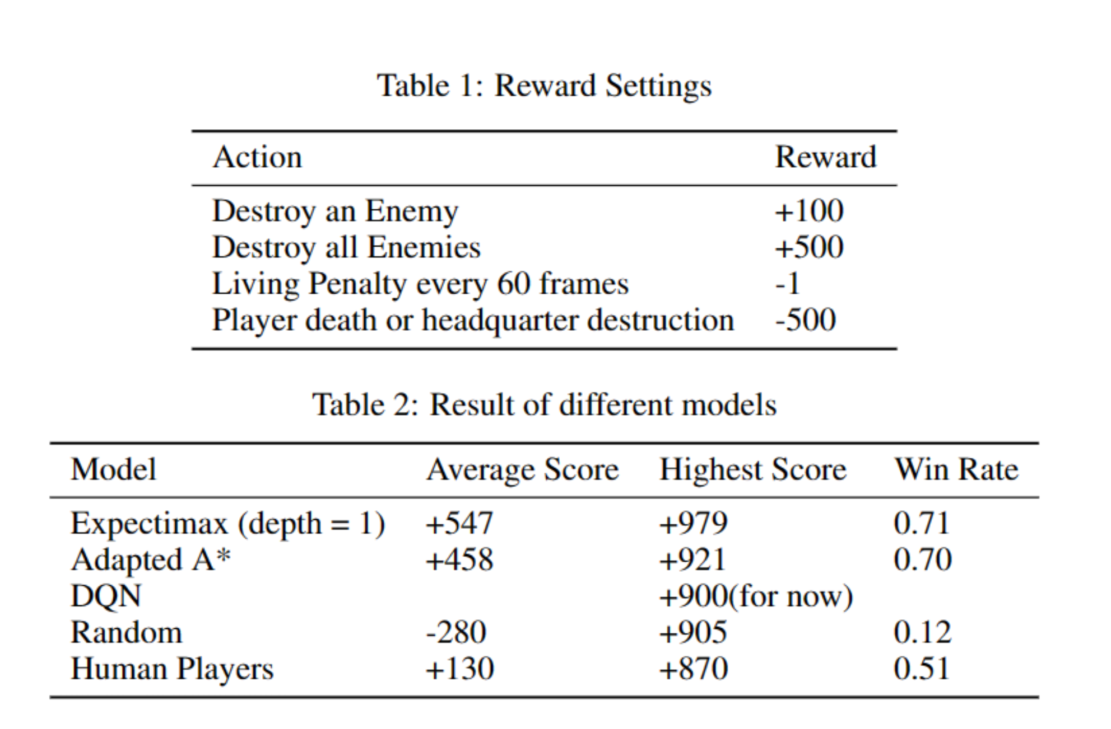
Some simplifications to the game
The game has
too many differernt states……
the movement of the hero and the enemies is continuous. It's not moving
grid by grid, but moving in pixels -> make its "moving" discrete
too much randomness……
different types of game props（time stationary, bonus, more life……） -> no props,
different types of enemies -> same type of enemies

Slide 4
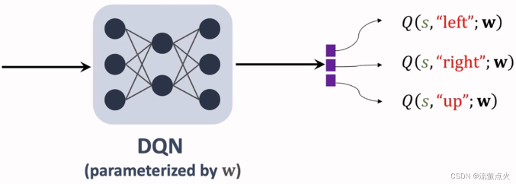

Design Agent
Baseline:
Random & Human Players
Search
A*
Expectimax
DQN
Q-learning
Deep Q-network
Notes:
off-policy: 可以使用历史数据进行学习，不受实时数据的限制。更容易实现高效的探索，因为行为策略可以专注于探索，而目标策略专注于性能。 Evalustion function 的迭代 DQN: 神经网络的的输入是状态s，输出是对所有动作a的打分

Slide 5
Search-A* and more
View bullets as walls and plan a path to the nearest enemy
The heuristic function considering：
the distance to the nearest enemy tank
the distance to the nearest enemy bullet
But this is not a traditional search, the enemies can move.
The path planned in the previous step will be abandoned
One idea: use the heuristic function and just pick the best first action
The game score remains unchanged, but the running speed increases

Slide 6
Search-Expectimax
Qustions: In original game, hero and enemies are premitted to move on less than 1 grid. So how to difine the "nextState"?
Our answer is discretization:
we only permit agent and enemies to move on the distance of the integer grid. In this way, we can difine the "nextState", which is the state after our agent move on a gird.
The evaluate function we use to judge the state:
It's not simple equal to the score of a state
Add punishment associate with distance from agent to enemies. If the agent is quite far away from all enemies, we will add punishment, in order to enourage it to approach them
Add another punishment. If the agent is in front of any enemy and close to it, it will have no time to skip bullet and lose the game. So we add punishment to avoid this condition
Notes:
坦克大战这个游戏本身允许玩家和敌方每次只移动不到一格，这对我们的算法带来了困扰。为了简化问题和状态，我们将游戏离散化，只允许玩家和敌方移动整格的距离。在此基础上，我们为游戏设计了Expectimax算法。玩家每次移动前，会判断向四个方向各移动一格，再分别使用evaluate函数评估每个动作好坏，并选出最优的动作。针对这个游戏，我们对evaluate做出了调整，evaluate返回的数值并不直接等同于状态的分数。首先，我们给evaluate添加惩罚项，agent距离玩家越远，惩罚越大，这样可以促使agent尽可能尝试接近敌方；另外，相较于Pacman游戏，敌方可以发射子弹，因此我们会添加额外的惩罚项，避免玩家出现在敌方正前方四格的距离。因为在这个范围内，如果敌方发射子弹，agent将无法躲避并游戏失败，所以要给这种状态添加很大的惩罚。

Slide 7
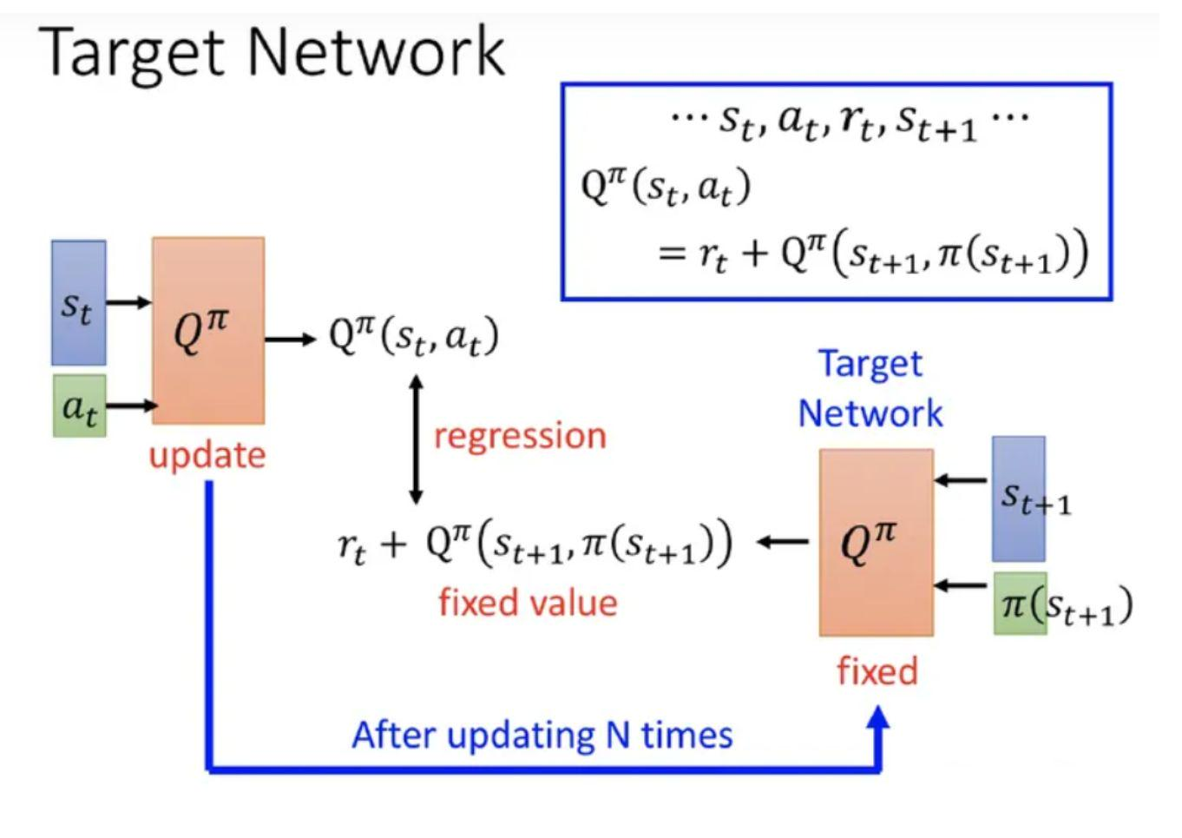
DQN
Network Structure:
Define the architecture of the DQN model. It consists of two main parts: features and fc.
The features part: sequential module composed of 2 convolutional layers and ReLU activation functions, used to extract features from the input state.
The fc part: composed of fully connected layers and ReLU activation functions, used to map the extracted features to the action space.
Mixed Target Network:
DQN has two Q-value networks.
The inner network: generates the Q-values for the current state, used for fitting the weight parameters.
The outer network, also known as the target network, used for sampling and generating experience replay. After several epochs, the weight parameters from the inner network are passed to the outer network for updating.

Slide 8
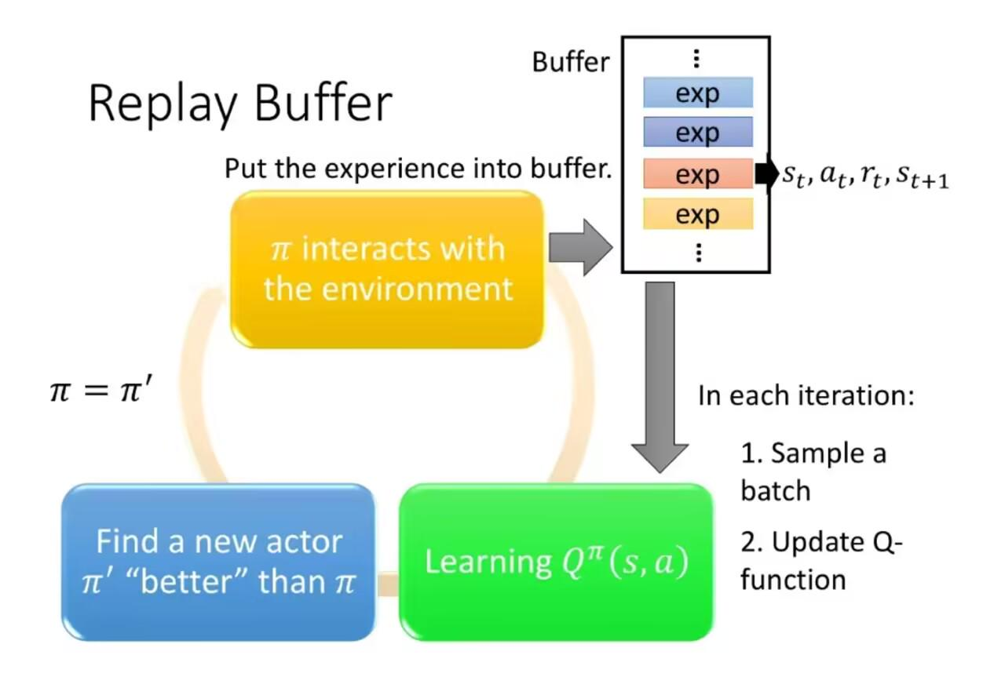
DQN
Replay Buffer:
It is implemented to store and sample experience data. It records previously sampled experiences to be reused during Q-value updates. By retrieving a batch of samples from the buffer during updates, the efficiency of sample utilization can be greatly improved.

Slide 9
Conclusion

Slide 10
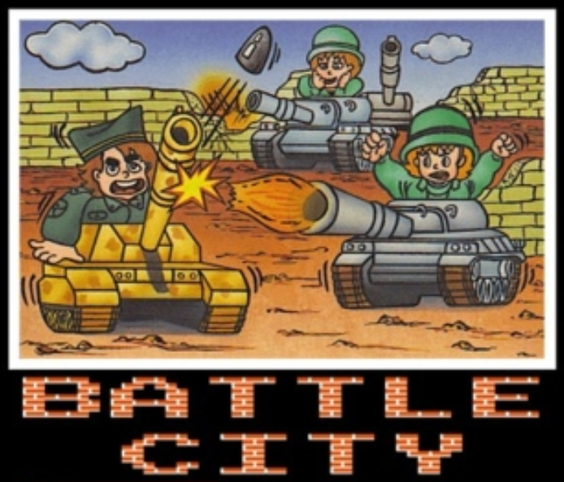
Conclusion
We observe that the agents are seemingly behaving less active than human players, this helps the agents to stay alive and get more points.
Search complexity grows with depth exponentially.
The deep Q learning model can perform better
with more training (still training and getting better)
More details will be explained in final report...

Slide 11
Thanks
何依阳：Q learning, Adapted A* Search Agent implementation and analysis
滕孜信：Deep Q Network implementation and analysis
汪洛： Expectimax Agent implementation and analysis
张晓夏：Essay---Related Work, Methodology, Experiment; Overall Planning
徐启翰：Essay---Introduction, Conclusion and revise
FINAL REPORT
Open Source Code of the pygame: https://github.com/IronSpiderMan/TankWar

